Slide 1

Using standard Logbook for testing quality assurance
Serology Team
International Laboratory Branch, DGHT
CDC Atlanta
June 4, 2024
RTCQI Best Practice Workshop – Africa Region, Cape Town

Slide 2
What is a standard logbook?
A standard HTS logbook/HTS register is a standardized tool for optimal documentation of HTS testing result.
It includes the quality elements through testing process
  Before testing: kit name, kit lot, kit expiration date, patient ID, demographic information of interests, test date
  During testing: result of individual test
  After testing: final interpretation per algorithm, tester name, other country-specific QA elements
It facilitates the use of logbook data for testing quality monitoring/improvement.
Notes:
Highlighted the element most of our interest.

Slide 3
How a standard logbook look like?

Slide 4
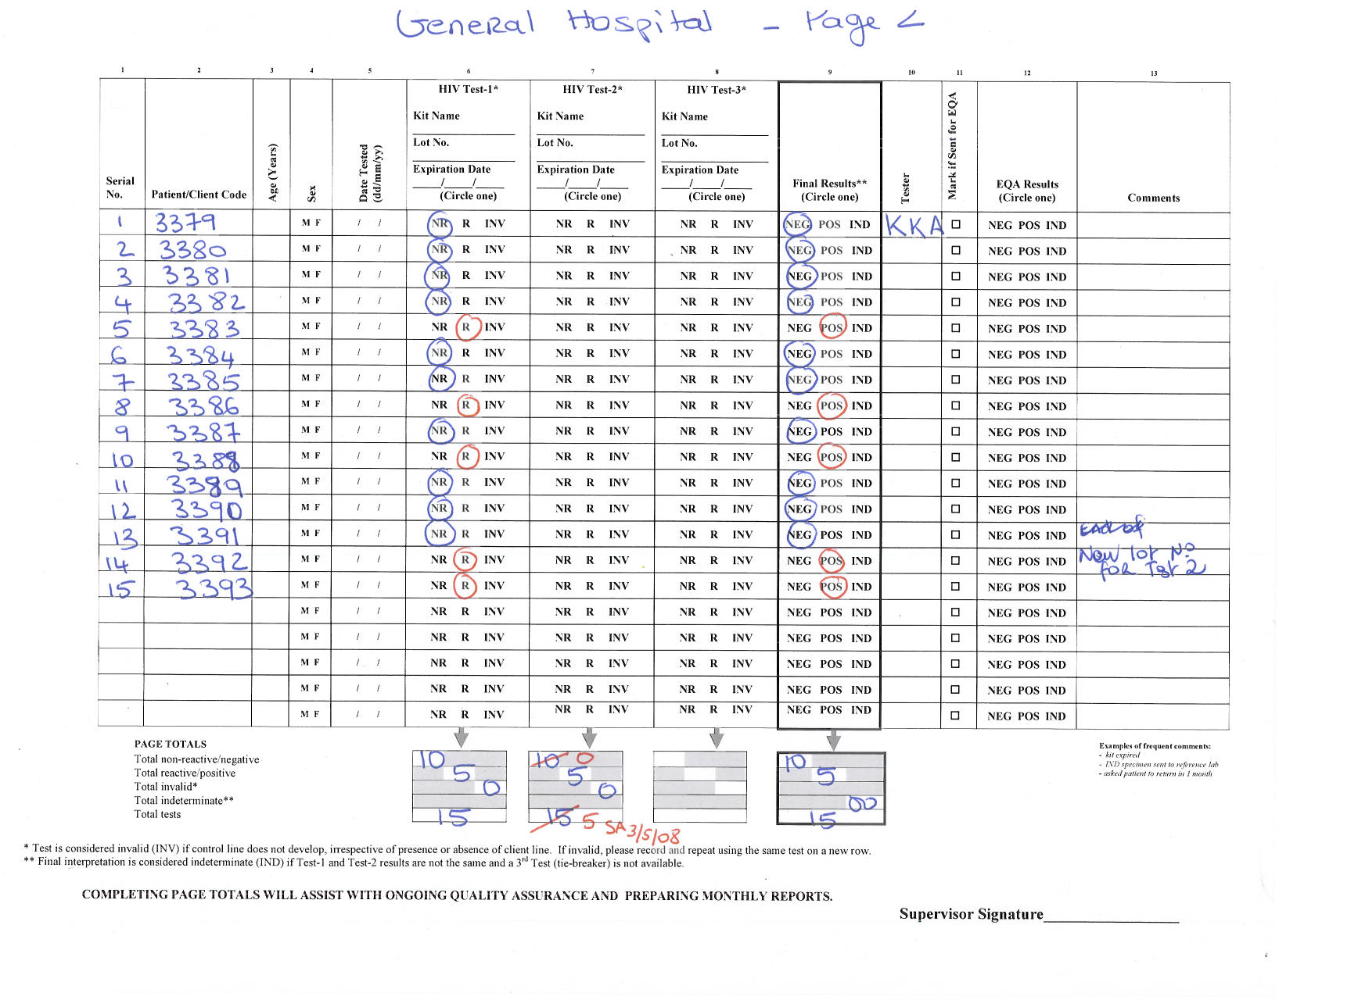
Use logbook to identify testing quality issue at site level – 1

Slide 5
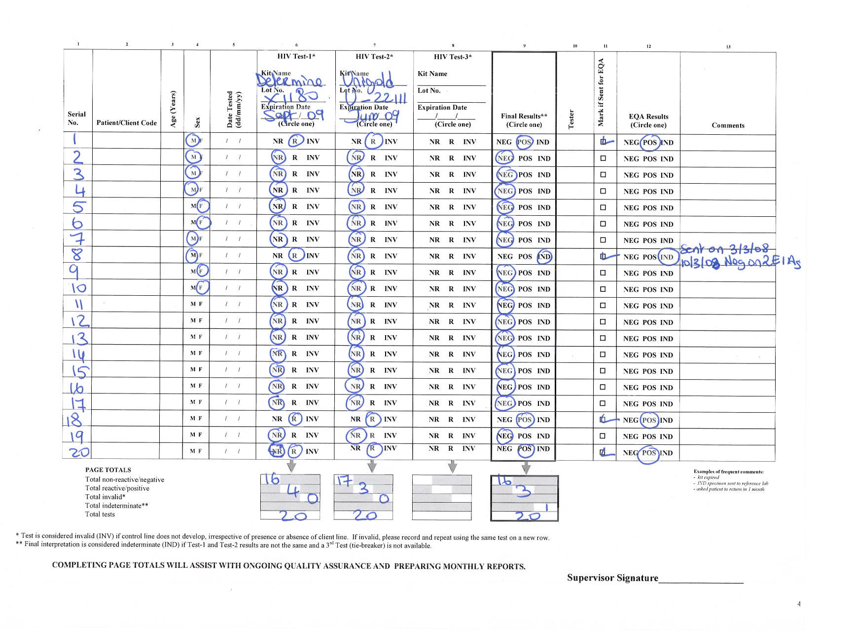
Use logbook to identify testing quality issue at site level – 2

Slide 6
Documenting Invalids

Slide 7
Aggregate Data Collection – HTS Register Summary Form

Slide 8
Data Analysis – above site level
The agreement rate between two tests is used to:
  Monitor testing quality over time
  Compare testing quality across operators
  Compare testing quality across sites
  Monitor performance of testing algorithm
Invalid rate is used to:
  Monitor invalid results overtime
Propose criteria:
  T1 vs. T2 Overall agreement rate ≥98%
  Rate of invalids < 1%
8

Slide 9
Ongoing Assessment of the Quality of HIV Rapid Testing
Same site over time
Different operators
% agreement between test 1 and 2
% agreement between test 1 and 2
Different Sites
Testing algorithm

Slide 10
Additional Data Analysis - Examples
Percentage of testing sites with the agreement rate < 98%
Distribution of Invalid test results by Test Kit
Determine
Stat - Pak
Uni-Gold
Percentage of testing sites with kit stock outs

Slide 11
Summary
The use of standard logbook for testing quality assurance
At site level
  If national algorithm was followed
  If kit were used within expiration date
  If the tester is competent with final result interpretation
  Any other gaps on records management
Above site level
  Monitor the performance of national algorithm
  Monitor the testing volume for optimal supply chain management
  Identify potential kit quality issue e.g.,
    prevalent high invalid rate
    Changed T1 & T2 agreement
Use the data for impact – develop corrective action to address identified gaps

Slide 12

Thank you!

